Slide 1
DATA ANALAYSIS AND VISUALIZATION
MINI PROJECT
Review-0

Slide 2
Analysis on Suicide Etiology

Slide 3
Team Members
Names | Roll No
Hitesh D | 20211IST0023
Shamitha R | 20211IST0020
Sushmitha V M | 20211IST0026

Slide 4
Problem Statement
Deaths or suicide cased through different causes all around the world.
More than 700 000 people die due to suicide every year.
For every suicide there are many more people who attempt suicide. A prior suicide attempt is an important risk factor for suicide in the general population.
Suicide is the fourth leading cause of death among 15–29-year-olds.
Seventy-seven per cent of global suicides occur in low- and middle-income countries.

Slide 5
Domains:
Social Science
Economics
Mental Health

Slide 6
Basic Motivation
To know the cause of deaths and help to reduce.
Using information available on social media, sentiment analysis can identify early signs of suicidal ideation and prevent attempts at suicide.
Data Science techniques to be effective tools in describing suicidal thoughts or behaviour, identifying individual risk factors and predicting outcomes.

Slide 7
Architecture
Data Collection
Data preprocessing
Feature Extraction
Model Selection
Data Analysis
Monitoring and Updating
Data Visualization

Slide 8
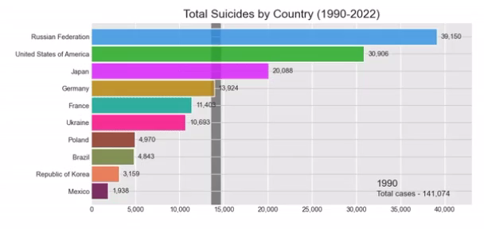

Slide 9
Thank You

